Slide 1
Getting Started in Office 365 with the Microsoft Graph API
Bernd Rickenberg
CTO @ Pointwork

Slide 2
Intro to the Microsoft Graph API
</>

Slide 3
Agenda
Intro to the Microsoft Graph API
Getting Started
Authentication
SDKs and Code Samples
Resources

Slide 4
1
Intro to the Microsoft Graph API

Slide 5
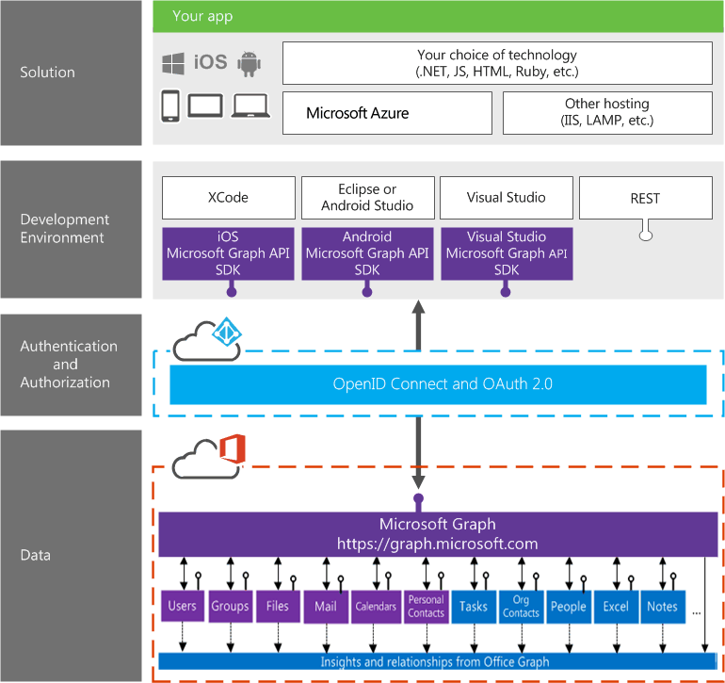
Building integration with Office 365
Notes:
Single resource that proxies multiple Microsoft services
Only one OAuth access token needed
Navigate across workloads and relationships logically

Slide 6






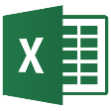

/groups
Shared with me
Shared with me
createdBy
createdBy
CONVERSATIONS
public
public
manager
directReports
directReports
directReports
directReports
EVENTS
EVENTS
modifiedBy
modifiedBy
FILES
FILES
memberOf
memberOf
GROUPS
GROUPS
createdBy
MESSAGES
FILES

Slide 7

Microsoft Graph Data
Active Directory
Users
profile
photo
direct reports
Groups
members
conversations
SharePoint
Sites
Lists
OneDrive
Files
upload
download
copy
versions
Outlook
Mail
messages
folders
send message
Calendar
events
find times
Excel
OneNote
Planner
Contacts
Directory
Webhooks
Beta
Teams
Insights
Project Rome
Devices
Activities
Intune
Reports
…and much more

Slide 8

Microsoft Graph Capabilities
Auth
Credentials
Work/School
Personal
OAuth scopes
User
App
OData
Filter
Order
Pagination
SDKs
.NET
JS
PHP
Android
iOS
Query patterns
Web hooks
Delta
Extensions
Batching
Other
Swagger
Visual Studio Tooling
Compliance

Slide 9
2
Getting Started

Slide 10
Demo Docs
https://graph.microsoft.com > documentation

Slide 11
Demo Graph Explorer
https://graph.microsoft.com > graph explorer

Slide 12

Get content
GET /me/drive/root/…
"value" : [
{"name": "demo.pptx",… },
{"name": "design.docx",… }
]
GET /me/messages
GET /me/events
GET /me/contacts
GET /me/onenote/notebooks
GET /me/planner/tasks
GET /me/devices
GET /me/drive/root/{id}/download
Documents
Calendar
Sites
Tasks
Email
Meetings
Contacts

Slide 13
Demo Quick Start
https://graph.microsoft.com > documentation

Slide 14
3
Authentication

Slide 15
Azure AD auth endpoints
endpoint
with ADAL
endpoint
with MSAL
v1.0
v2.0
Work and school
Personal
http://aka.ms/aadv2

Slide 16
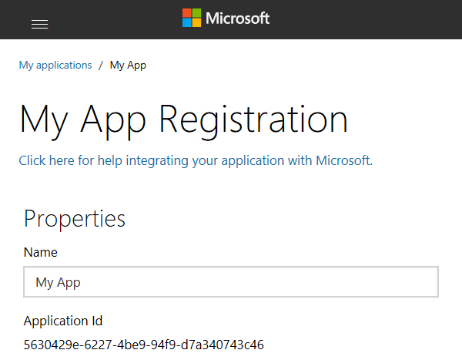
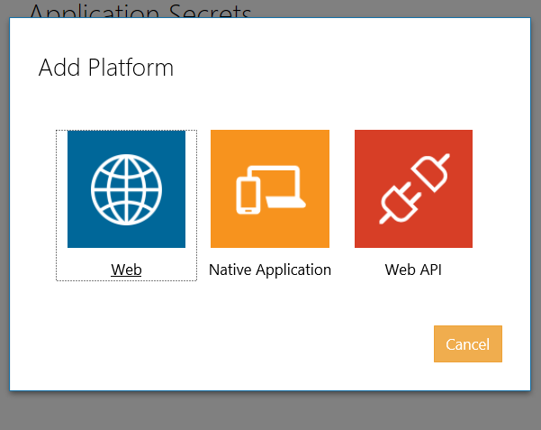
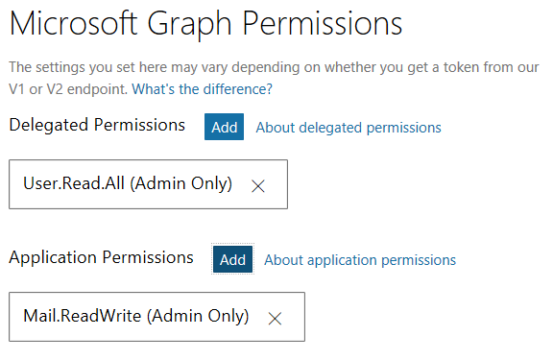
App registration v1.0
Create a new application
https://apps.dev.microsoft.com
A unique Id is created for your app
Add app platform
Web App, SPA, Daemon
Native App
Web API (Office Add-in)
Add permissions for admin consent flows
For delegated access for all users in the organization
For application access

Slide 17
App registration v2.0
Create a new application
https://apps.dev.microsoft.com
A unique Id is created for your app
Add app platform
Web App, SPA, Daemon
Native App
Web API (Office Add-in)
Add permissions for admin consent flows
For delegated access for all users in the organization
For application access

Slide 18
Authentication
Microsoft Identity
id_token
access_token
refresh_token
YOUR APP
MSAL or ADAL
access_token
Microsoft Graph

Slide 19
Authentication to Microsoft Graph using resource ID
NATIVE APPLICATION
AZURE AD AUTHORIZATION ENDPOINT
AZURE AD TOKEN
ENDPOINT
MICROSOFT GRAPH API
Request authorization code
Sign-in via browser pop-up
Return authorization code
Redeem authorization code and acquire access token for Office 365 resource
Return access token and refresh token
Call Office 365 with the Microsoft Graph API using the access token
Return Http response
Notes:
** This slide has animations **
To facilitate the issuance of tokens for multiple resources, a different approach is required.
Instead of requesting an access token from the Authorization Endpoint, an authorization code is requested. The Resource Id for which a token is desired in included in the call to the Authorization Endpoint. The Authorization Endpoint will ensure the user is logged in, and will present the Common Consent dialog that lists the permissions requested by the application.
The authorization code is redeemed at the new Token Endpoint, which returns an access token and a refresh token. The token is issued for the resource identified in the authorization code request.
The access token is used to access the resource. The access token represents the user’s permissions to the resource. The application permission is granted during common consent.

Slide 20
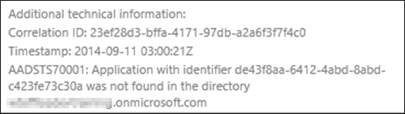
Troubleshooting errors in Auth flow
Login errors
Shown on web page
Fiddler
Shows response/request from apps running on local computer
Review response as JSON
Authentication errors (invalid values)
{"error":"invalid_grant","error_description":"AADSTS70002: Error validating credentials. AADSTS50011: The reply address 'http://localhost:40298/Home/Discovery' is not valid.}

Slide 21
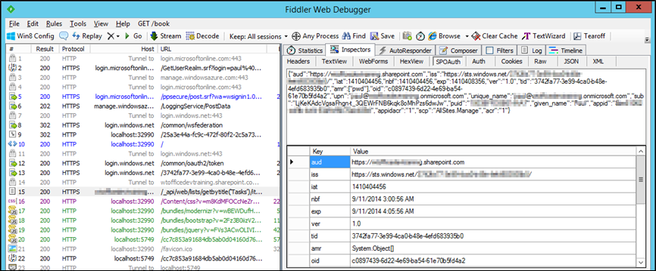
Troubleshooting tokens
Fiddler
Extension to view SharePoint 2013 App tokens
http://blogs.msdn.com/b/kaevans/archive/2013/08/25/creating-a-fiddler-extension-for-sharepoint-2013-app-tokens.aspx
Online Paste token in web page
http://jwt.io/

Slide 22
4
SDKS and Code samples

Slide 23
Demo Azure Functions Bindings (Preview)

Slide 24

New Azure function bindings
PREVIEW
Bindings for Microsoft Graph
Uses Microsoft Graph .Net SDK
Auth is handled for you!!!
Microsoft Graph
Web hook
triggers function
Azure Function queries
Microsoft Graph

Slide 25
5
Resources

Slide 26

Resources
Documentation, samples and more:
https://graph.microsoft.com/
Stack overflow:
[Microsoft-Graph] and [Office-365]
Twitter:
#MicrosoftGraph and #Office365dev

Slide 27
Further reading…
Getting Started with APIs
Microsoft Graph API Code Samples
Microsoft Graph API Training videos & hands on labs
Microsoft Graph API documentation

Slide 28
Developer Program
1 YEAR FREE
E-mail Newsletters
Free Developer Subscription
Free Training
Free Tools
Webinars
http://dev.office.com/devprogram

Slide 29


Engage
Office 365 Network
https://www.yammer.com/itpronetwork
Twitter
S
S
t
t
a
a
r
r
t
t
@OfficeDev
Stack overflow
[ms-office]
Channel 9 Dev Show
http://aka.ms/O365DevShow
Podcasts http://dev.office.com/podcasts
Snack Demos
http://aka.ms/o365DevSnackDemos
UserVoice
http://officespdev.uservoice.com/

